Slide 1




OPTIMAL SCHEDULING OF DRONE DELIVERIES IN A SMART CITY

Slide 2
Group members
MUHAMMAD FARHAN BIN HASRAT NAZARUDIN 210924
MUHAMMAD ZAHIN BIN MAHAT 210270
MUHAMMAD NURI BIN MOHD ALI 205768

Slide 3
Table of contents
PROBLEM STATEMENT
PROPOSED SOLUTION
ALGORITHM COMPARISON
DESIGN ALGORITHM
OUTPUT
ALGORITHM ANALYSIS
SUMMARY

Slide 4

problem statement

Slide 5
Problem statement
In the smart city of Shenzhen, a drone delivery service has been implemented to streamline package deliveries. The city is divided into different sectors, and each sector has a set of delivery points that drones must visit. Each drone has a limited battery life that can support a maximum number of delivery points before it needs to return to the base for recharging. Additionally, each package has a specific delivery time window during which it must be delivered. The challenge is to schedule the drones so that all packages are delivered within their respective time windows while minimizing the total distance traveled by the drones.

Slide 6
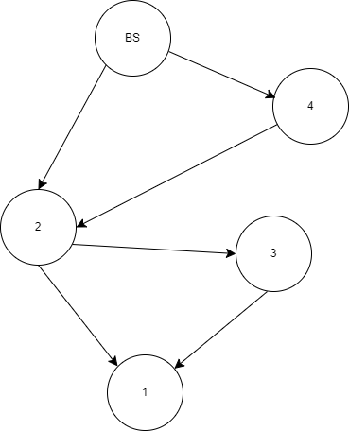
Key components in Problem statement
Geographical Settings: Shenzhen , China
Drones
Battery Life: Each drone has a limited battery life that supports a maximum number of delivery points (e.g., a drone can visit up to 10 delivery points before needing to return to the base for recharging).
Return to Base: Drones must return to a designated base for recharging after reaching their battery limit.
2. Packages
Delivery Time Windows: Each package has a specific time window during which it must be delivered (e.g., Package A must be delivered between 10:00 AM and 11:00 AM).
Scheduling: The challenge is to schedule the deliveries so that all packages are delivered within their respective time windows.

Slide 7
proposed solutions

Slide 8
proposed solution
Minimize the total distance traveled by the drones.
Ensure all packages are delivered within their specified time windows.
Optimize the utilization of available drones to reduce the need for additional resources.
Develop a scalable solution that can handle increasing delivery demands as the city grows.

Slide 9
Why finding
optimal solution
is important
Efficiency
Optimizing the delivery routes minimizes the total distance traveled, leading to lower energy consumption and longer drone battery life.
2. Customer Satisfaction
Ensuring that packages are delivered within their specified time windows increases customer satisfaction and trust in the delivery service.
3. Resource Utilization
An optimal solution ensures that the available drones are used efficiently, reducing the need for additional drones and lowering operational costs.
4. Scalability
A well-optimized system can handle increased demand more effectively as the city grows and the number of deliveries increases.

Slide 10
Algorithm Comparison

Slide 11
Algorithm | Strengths | Weaknesses | Applicability to the Problem
Sorting | Simple to implement and understand. Useful for ordering deliveries based on time windows | Does not address route optimization. Cannot ensure minimal travel distance | Can be used as a preliminary step but not as the main algorithm
Divide and Conquer (DAC) | Effective for problems that can be broken into smaller, independent subproblems | Involves overlapping subproblems and dependencies, making it less suitable | Not suitable due to overlapping subproblems and dependencies in delivery routing
Dynamic Programming (DP) | Handles overlapping subproblems. Finds optimal solutions by breaking problems into simpler subproblems | Computationally expensive in terms of time and space complexity | Well-suited for route optimization with time windows and battery constraints
Greedy Algorithms | Simple and fast. Makes local optimal choices | May not always provide globally optimal solutions for complex problems | Can provide a quick, approximate solution but not guaranteed to be optimal
Graph Algorithms | Suitable for route optimization. Algorithms like Dijkstra's and A* can find shortest paths | Extensive computation for large graphs. Adding time window constraints adds complexity | Useful for finding shortest paths but may struggle with added constraints

Slide 12
Chosen algorithm
Dynamic Programming
Handles Overlapping Subproblems
DP efficiently manages overlapping subproblems by storing and reusing results, making it suitable for problems where solutions to subproblems overlap, such as route optimization with multiple constraints.
Optimal Solutions
DP is designed to find optimal solutions by considering all possible subproblem combinations, which is essential for minimizing total travel distance while adhering to time windows and battery constraints.

Slide 13
Design an algorithm

Slide 14
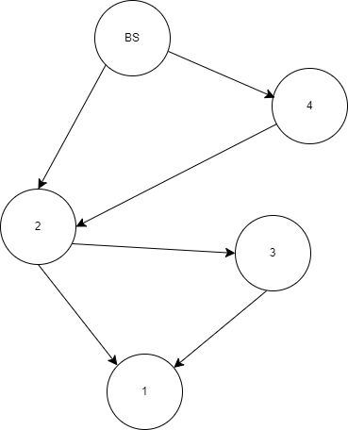
Algorithm desgign
(dynamic programmin
Idea
The DP approach breaks down the main problem into smaller subproblems, solving each subproblem only once and storing the results for future use.
Recurrence
The recurrence relation is used to update the DP table. In this algorithm, the state is represented by two variables: the current node (u) and a bitmask (mask) representing the set of visited nodes.

Slide 15
OUTPUT

Slide 16
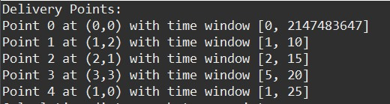
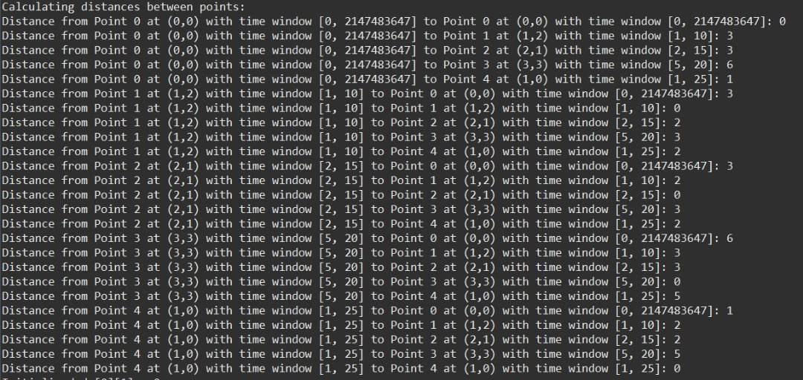
Delivery points:
Calculating Distance Between Point:

Slide 17
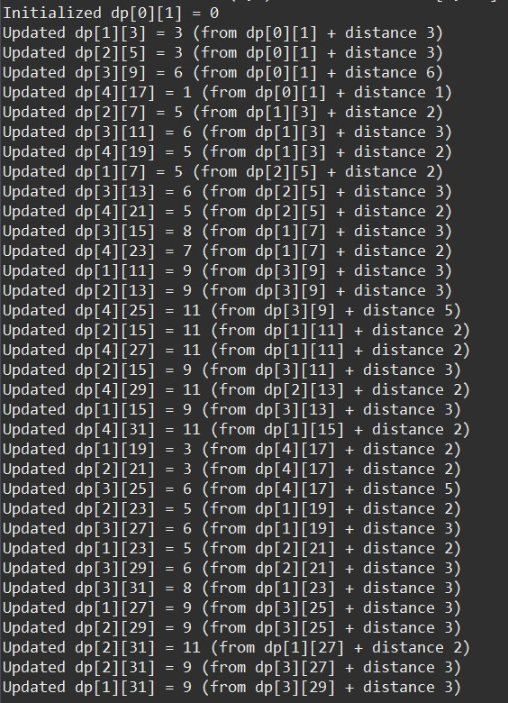

Progress Update
Result

Slide 18
ALGORITHM ANALYSIS

Slide 19
Correctness
Visiting Delivery Points within Time Windows
The algorithm checks the time constraints during the DP state transitions.
For each delivery point, it verifies that the drone can reach it within its specified time window, ensuring that all delivery points are visited within their respective time windows.
Minimal Distance Travelled
The DP table keeps track of the minimum distances for each subset of visited nodes.
By updating this table based on the minimum distance to reach each node, the algorithm guarantees that the final path selected will be the one with the minimal total distance traveled among all possible paths that satisfy the time window constraints.

Slide 20
time complexity of algorithm
Best-case scenario:
The best-case scenario occurs when the algorithm can quickly find an optimal solution without having to explore many subsets of delivery points.
This could happen if the delivery points are arranged in a way that allows the algorithm to reach all points with minimal backtracking.
The best-case time complexity is still O(n * 2^n), as the algorithm needs to consider all subsets of delivery points.

Slide 21
Average-case scenario:
The average-case scenario depends on the distribution of delivery points and the complexity of their connections.
In typical scenarios, the algorithm might need to explore a significant portion of the subsets to find the optimal solution.
The average-case time complexity is also O(n * 2^n).

Slide 22
Worst-case scenario:
The worst-case scenario occurs when the algorithm needs to explore all possible subsets of delivery points to find the optimal solution.
This could happen if the delivery points are arranged in a way that requires the algorithm to backtrack extensively to explore different routes.
The worst-case time complexity remains O(n * 2^n).

Slide 23
summary

Slide 24
The drone delivery service in Shenzhen uses advanced algorithms, including dynamic programming and graph algorithms, to optimize delivery logistics by minimizing travel distance and ensuring timely deliveries. This approach enhances efficiency, reduces energy consumption, improves customer satisfaction, and lowers operational costs. The scalable system effectively models the city as a graph, providing a robust solution for future urban logistics.

Slide 25

thank you

